Slide 1

Application Traffic Live Assurance System
Aijun Wang(China Telecom)
Jing Liu(Tencent)
Dr. Lei Wang(Tsinghua)
Cisco ODL BootCamp Group 10

Slide 2
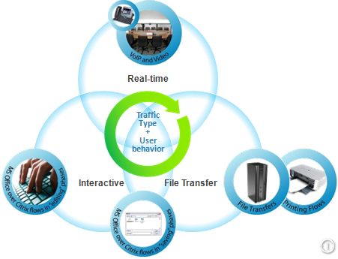
Why Application Traffic?
Traffic Engineering is one traditional topic in recent decades
There are many solutions to it, MPLS-TE, RSVP, various Tunnels etc.
It is the requirements from various Application Providers propel the emerge and adoption of SDN technology.
Then every SDN solution should be served the requirement of application traffic.
Not the general traffic engineering, which is the responsibility of traditional management platform.

Slide 3

Why Live?
No one can estimate the real traffic volume in WAN network
The world is change quickly.
Mobile Applications exacerbate the traffic congestion and network challenge situation
Traffic is changing with time, with different directions quickly.
Service Provider must find some way to meet the Live requirements.
It seems SDN, ODL and our solution can achieve this ☺

Slide 4


How Assurance?
Integration of centralized(SDN) and distribution(IGP/BGP) control methods.
Suitable for Native IP and MPLS based network
Little change to the production network of service provider
Application Traffic Live Assurance System ATLAS, which is based on ODL
BGP-LS/NETCONF/PCEP
MAN
Tencent
Cloud IDC
R4
R5
R6
R7
R8

Slide 5
Network Solution
lo1
BGP Peer Pair2
lo1
Build two BGP Pairs
Every Pair announces different prefixes.
Every BGP next-hop can be reached via different physical link.
Most configuration works lie in edge routers(PE). Transit routers should be changed as little as possible.
All above parameters can be changed dynamically.
BGP Peer Pair1
lo0
lo0
IP₁
A.2
A.3
IP₂
A.6
A.7
R1
A.10
A.11
R2
GW-1
GW-2
R3
(RR)
AS XXX
R5
R6
GW1
R1
R7
GW2
R2
R4

Slide 6
ATLAS System Architecture
User Interface(Policy Definition)
Policy
Path Calculation
Topology Discover
Path Adjustment
Developped
Related
Base Network Service Functions
Network Topology
Network
Status
YANG
Based Module
Topo
Status
Node
FRM
Future
Model-Driven Service Abstraction Layer (MD-SAL)
Controller
Platform
NETCONF
Router Configuration
BGP-LS
Topology Collection
PCEP
SNMP
Network Status
Southbound Protocol Plugins
Cisco Router
Cisco IOS XRV/NetConf
Cisco Router

Slide 7
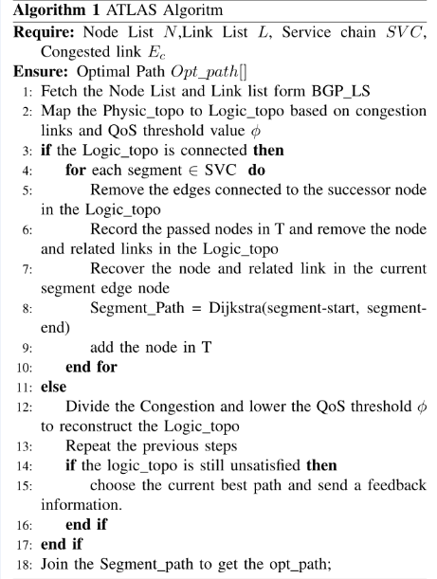
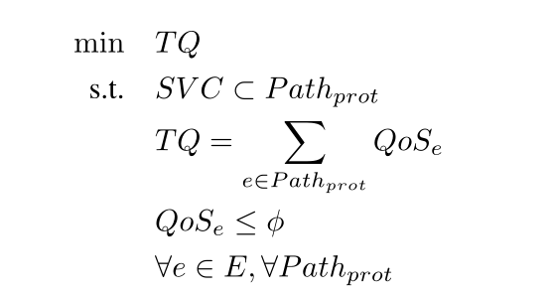
Path Optimal Algorithm
Destination
3
4
5
2
7
6
Source
1
8
Path formula, by Dr.Lei Wang
Collect topology/user policy
Divided and Conquered Principle
Select every optimal path segment to meet above formula
Construct and output the optimal path.

Slide 8
Predecessor Works
51
2
54
1
por
sfc
1
2
Deduce the real topology via ISIS LSDB
Change the metric for some node
Compare the router’s trace path with the result of ATLAS’s algorithm
53
56
1
4
3
2
sea
3
55
3
sjc
0
57
0
min
2
1
2
49
46
44
5
3
lax
0
kcy
30(kcy): 21.21.21.21 31(lax): 22.
32(min):24 33(por):26
34(san):27 35(sea):28
36(sfc):29 37(sjc):30
1
45
4
48
3
san
2

Slide 9
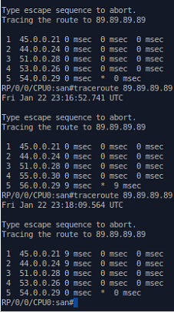
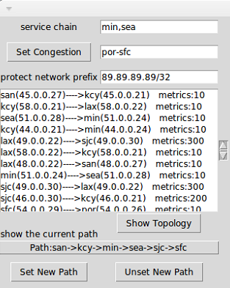
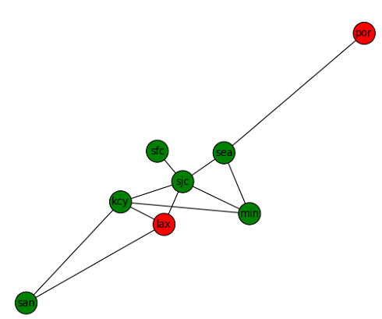
Current Results
Fig. 2 Topology and Optimal Path Output
Fig.3 Optimal Path Verification
Fig. 1 Topology and Policy Input

Slide 10
Future Consideration
Algorithm Optimization
Yang Model Based Module
PCE
Project Incubation within ODL community
Individual Contribution within ODL

Slide 11

Kind Teachers:
Chuck
Giles
Donald
Hard Working Volunteers
Every ODLer

